Slide 1
Lecture 02
File and File system

Slide 2
Topics
Describe the layout of a Linux file system
Display and set paths
Describe the most important files, including kernel and shell
Find lost and hidden files
Create, move and delete files and directories
Display contents of files
Understand and use different link types
Find out about file properties and change file permissions

Slide 3
Files
"On a UNIX system, everything is a file; if something is not a file, it is a process.“
Regular file: executable program, text etc.
Directories: files that are lists of other files.
Special files: the mechanism used for input and output. Most special files are in /dev,
Links: a system to make a file or directory visible in multiple parts of the system's file tree.
(Domain) sockets: a special file type, similar to TCP/IP sockets, providing inter−process networking protected by the file system's access control.
Named pipes: act more or less like sockets and form a way for processes to communicate with each other, without using network socket semantics.
The −l option to ls displays the file type, using the first character of each input line: ls – l / ls –F --color

Slide 4
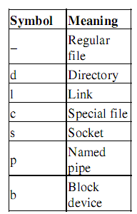
File types in a long list

Slide 5
Partitions
Why?
    to achieve higher data security in case of disaster.
    for security and robustness reasons, so a breach on one part of the system doesn't automatically mean that the whole computer is in danger.

Slide 6
There are two kinds of major partitions on a Linux system:
  data partition: normal Linux system data, including the root partition containing all the data to startup and run the system;
  swap partition: expansion of the computer's physical memory, extra memory on hard disk.

Slide 7
ROOT Space
The standard root partition (indicated with a single forward slash, /) is about 100−500 MB, and contains the system configuration files, most basic commands and server programs, system libraries, some temporary space and the home directory of the administrative user. A standard installation requires about 250 MB for the root partition.

Slide 8
SWAP Space
Swap space (indicated with swap) is only accessible for the system itself, and is hidden from view during normal operation. Swap is the system that ensures, like on normal UNIX systems, that you can keep on.
On Linux, you will virtually never see irritating messages like Out of memory,please close some applications first and try again, because of this extra memory.
Linux generally counts on having twice the amount of physical memory in the form of swap space on the hard
disk.

Slide 9
The df command:
    df -h
    df -h .

Slide 10
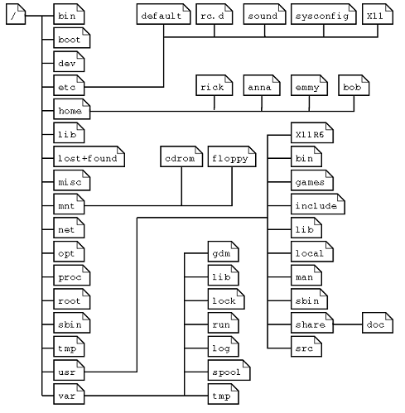
Linux file system layout

Slide 11
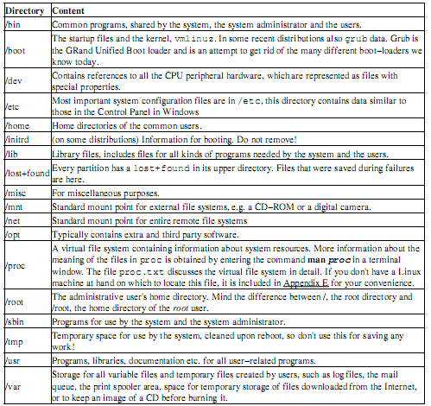
Subdirectories of the root directory

Slide 12
The file system in reality
Every partition has its own file system. In a file system, a file is represented by an inode, a kind of serial number containing information about the actual data that makes up the file:
    Owner and group owner of the file.
    File type (regular, directory, ...)
    Permissions on the file
    Date and time of creation, last read and change.
    Date and time this information has been changed in the inode
    Number of links to this file
    File size
    An address defining the actual location of the file data.
Every partition has its own set of inodes; throughout a system with multiple partitions, files with the same inode number can exist.
The only information not included in an inode, is the file name and directory. These are stored in the special directory files.
ls -i

Slide 13
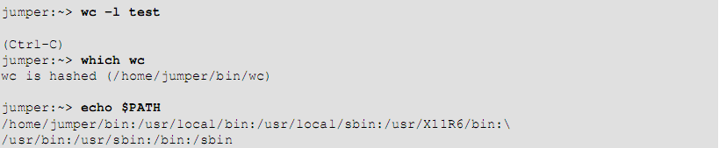
The Path
Absolute and relative paths

Slide 14
The most important files and directories
The kernel: The kernel is the heart of the system.
  It manages the communication between the underlying hardware and the peripherals.
  The kernel also makes sure that processes and daemons (server processes) are started and stopped at the exact right times.
The shell:
  "a shell manages the interaction between the system and its users".
  "bash is an sh−compatible command language interpreter,“
Your home directory:
  echo $HOME
  (~)
  Use man or info quota

Slide 15

Shell
Your default shell is set in the /etc/passwd file, like this line for user mia:
To switch from one shell to another, just enter the name of the new shell in the active terminal.
echo $SHELL

Slide 16
The most important configuration files
stored in the /etc directory
Also , man group

Slide 17
The most common devices
entry in the /dev directory

Slide 18
The most common variable files
In the /var directory we find a set of directories for storing specific non−constant data
All files that change frequently, such as log files, mailboxes, lock files, spoolers etc. are kept in a subdirectory of /var.
var/tmp and /tmp :temporary files
/var/log : user login information
/var/spool : scheduled tasks
/var/spool/mail
/var/lib/rpm: redhat package manager lib

Slide 19
Manipulating files
ls –a
ls −al
ls −latr
Color scheme:The standard scheme is in
/etc/DIR_COLORS
file command

Slide 20
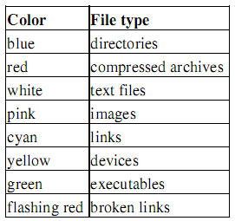
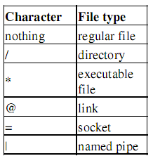

Slide 21
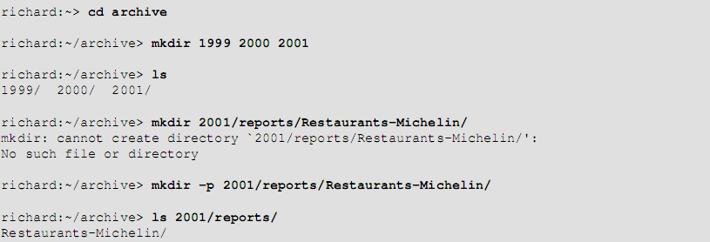
Tools
Creating directories: mkdir
Moving files: mv
Copying files: cp –R fromFileile toFile
Remove files : rm –ri archive/

Slide 22
Finding files
find document.gif
ls dirname/*/*/*[2−3]
Using shell features: Tab key twice
which command:
    which –a ls
find <path> −name <searchstring>
    This can be interpreted as "Look in all files and subdirectories contained in a given path, and print the names of the files containing the search string in their name" (not in their content).
Another application of find is for searching files of a certain size
    find . −size +5000k

